Slide 1
CS 326: Software Engineering
Analysis Model-Class Diagram
Practice Session
Video Lecture: https://www.youtube.com/watch?v=xiUFTLIU-lw

Slide 2
What is a Class Diagram?
Suppose you have to design a system. Before implementating a bunch of classes, you’ll want to have a conceptual understanding of the system — that is, what classes do I need? What functionality and information will these classes have? How do they interact with one another? Who can see these classes? And so on.
That’s where class diagrams come in. Class diagrams are a neat way of visualizing the classes in your system before you actually start coding them up. They’re a static representation of your system structure.
This is a fairly simple diagram. However, as your system scales and grows, it becomes increasingly difficult to keep track of all these relationships. Having a precise, organized, and straight-forward diagram to do that for you is integral to the success of your system.

Slide 3
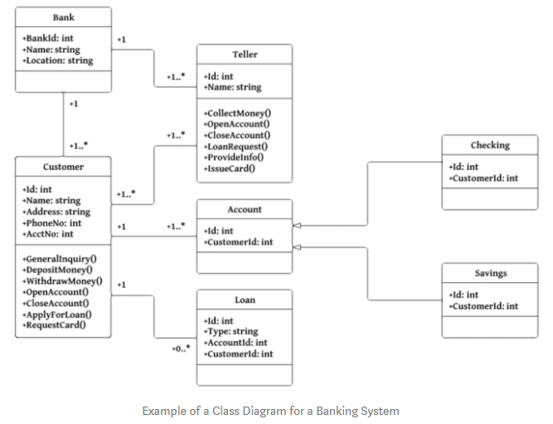
What is a Class Diagram?

Slide 4
Why do we need class diagrams?
Planning and modeling ahead of time make programming much easier.
Besides that, making changes to class diagrams is easy, whereas coding differnent functionality after the fact is kind of annoying.
When someone wants to build a house, they don’t just grab a hammer and get to work. They need to have a blueprint — a design plan — so they can ANALYZE & modify their system.
You don’t need much technical/language-specific knowledge to understand it.
(More on next slide)

Slide 5
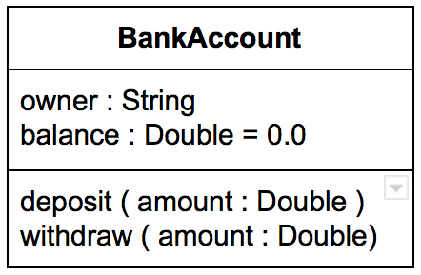
Class Representation in UML
A class is represented as a box with 3 compartments. The uppermost one contains the class name. The middle one contains the class attributes and the last one contains the class methods. Like this:
They adhere to the following convention:
attribute name : type
method name (parameter: type)
if you’d like to set a default value to an attribute do as above balance : Dollars = 0
if a method doesn’t take any parameters then leave the parentheses empty. Ex: checkBalance()

Slide 6
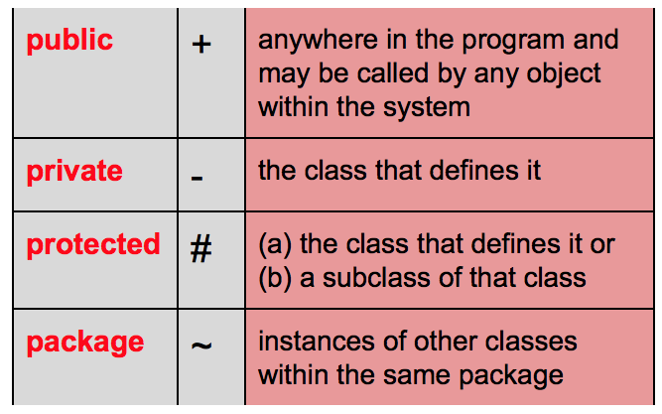
Visibility of Class Members

Slide 7
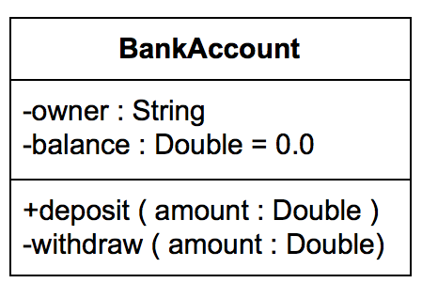
Visibility of Class Members
Let’s specifiy the visibility of the members of the BankAccount class above.
We made the `owner` and balance private as well as the withdraw method. But we kept the deposit method public. (Anyone can put money in, but not everyone can take money out. Just as we like it.)

Slide 8
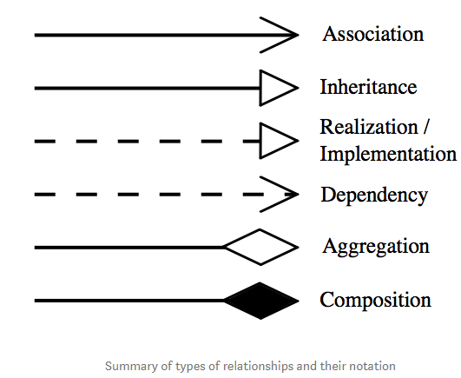
Relationships

Slide 9
Association
Assocation is a relationship between two separate classes. There are four different types of association:
  Bi-directional,
  Uni-directional
  Aggregation (includes composition aggregation)
  Reflexive
Bi-directional and uni-directional associations are the most common ones.
This can be specified using multiplicity (one to one, one to many, many to many, etc.).
A typical implementation in Java is through the use of an instance field. The relationship can be bi-directional with each class holding a reference to the other.

Slide 10
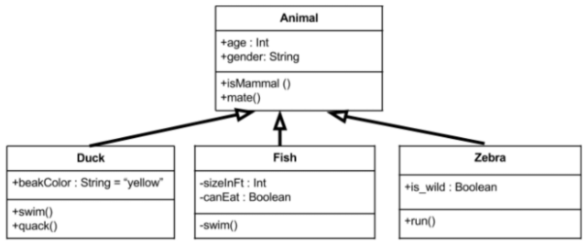
Inheritance
Indicates that child (subclass) is considered to be a specialized form of the parent (super class). For example consider the following:
Above we have an animal parent class with all public member fields. You can see the arrows originating from the duck, fish, and zebra child classes which indicate they inherit all the members from the animal class. Not only that, but they also implement their own unique member fields. You can see that the duck class has a swim() method as well as a quack() method.

Slide 11
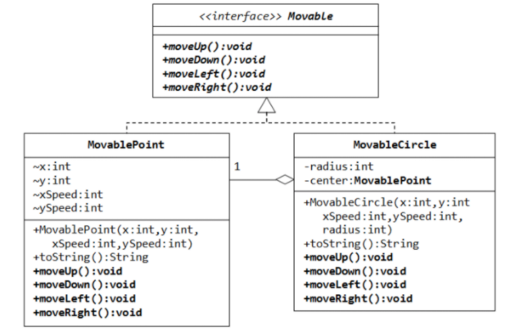
Realization/Implementation
A relationship between two model elements, in which one model element implements/executes the behavior that the other model element specifies.

Slide 12
Dependency

Slide 13
Aggregation
A special form of association which is a unidirectional (a.k.a one way) relationship between classes.
The best way to understand this relationship is to call it a “has a” or “is part of” relationship.
For example, consider the two classes: Wallet and Money.
A wallet “has” money.
But money doesn’t neccessarily need to have a wallet so it’s a one directional relationship.

Slide 14
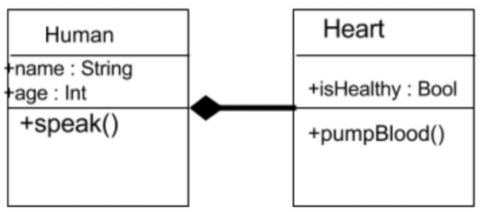
Composition
A restricted form of Aggregation in which two entities (or you can say classes) are highly dependent on each other.
A human needs a heart to live and a heart needs a human body to function on.
In other words when the classes (entities) are dependent on each other and their life span are same (if one dies then another one too) then its a composition.

Slide 15
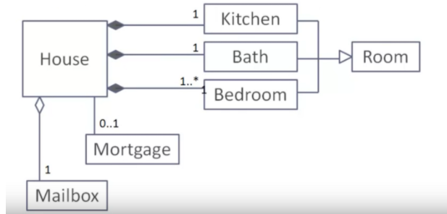
Multiplicity
After specificyfing the type of association relationship by connecting the classes, you can also declare the cardinality between the associated entities. For example:
The above UML diagram shows that a house has exactly one kitchen, exactly one bath, atleast one bedroom (can have many), exactly one mailbox, and at most one mortgage (zero or one).

Slide 16
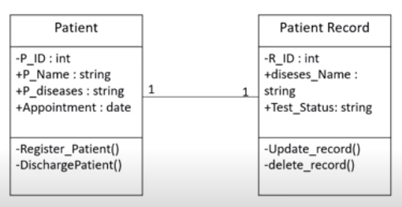
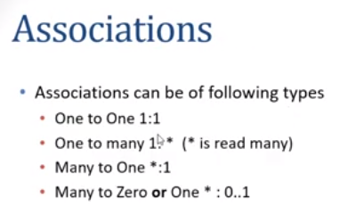
Association

Slide 17
Exercises

Slide 18
Class diagram for a banking system
Must have the followng classes
  Bank
  ATM
  Customer
  Account
  Transaction
  Checking Account
  Savings Account

Slide 19
Class diagram for a banking system
  Bank Class
  The bank class represents a physical bank. It has a location and a unique id. This bank also manages several accounts. **There’s an association!** What type of association is this? Is a bank entirely composed of accounts (composition)? Or are accounts ‘part of’ a bank (aggregation)? It looks like aggregation. It can’t be composition because that would mean that both classes live and die together. That’s not quite right because you can have a bank without accounts and you can have accounts without a bank. We’ll add a method called getAccounts().

Slide 20
Class diagram for a banking system
  ATM Class
  The ATM class represents a physical ATM. Right off the bat, we can come up with three methods for the ATM: withdraw(), deposit(), checkBalance(). Each of these methods takes the card number as input. In terms of attributes, an ATM has a location and is managed by a specific bank.

Slide 21
Class diagram for a banking system
  Customer Class
  The customer class represents a real customer. This customer has a name, address, date of birth (dob), card number, and pin. For this person to be considered a customer, they must have an account. **There’s another association!** This isn’t aggregation or composition, it’s just a bi-directional association (drawn using a blank line no arrows).

Slide 22
Class diagram for a banking system
  Account Class
  The account class represents a bank account. Common attributes of bank accounts include account number, balance, etc. You can deposit() withdraw() money from the account. In addition, banks might offer two types of accounts: a checking account and a savings account. These two can thus be considered child classes of the account class and can inherit from it too. We’ll denote this by using a solid black line with an unfilled arrow going into the account class.

Slide 23
Class diagram for a banking system
  Account Class
  The account class represents a bank account. Common attributes of bank accounts include account number, balance, etc. You can deposit() withdraw() money from the account. In addition, banks might offer two types of accounts: a checking account and a savings account. These two can thus be considered child classes of the account class and can inherit from it too. We’ll denote this by using a solid black line with an unfilled arrow going into the account class.

Slide 24
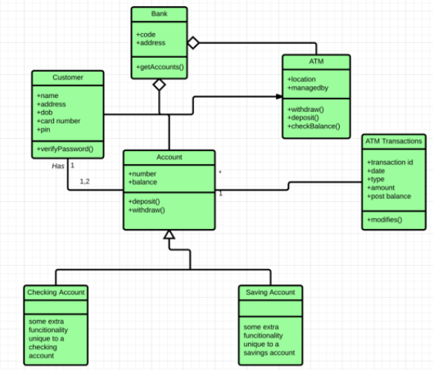
Class diagram for a banking system

Slide 25
Class diagram for a E-Shop
Must have the followng classes
  Customer
  Web User
  Account
  Shopping Cart
  Product
  Order
  Payment

Slide 26
Class diagram for a E-Shop
Each customer has unique id and is linked to exactly one account. Account owns shopping cart and orders.
Customer could register as a web user to be able to buy items online.
Customer is not required to be a web user because purchases could also be made by phone or by ordering from catalogues.
Each customer has unique id and is linked to exactly one account.

Slide 27
Class diagram for a E-Shop
Account owns shopping cart and orders.
Customer could register as a web user to be able to buy items online.
Customer is not required to be a web user because purchases could also be made by phone or by ordering from catalogues.
Web user has login name which also serves as unique id.

Slide 28
Class diagram for a E-Shop
Web user could be in several states - new, active, temporary blocked, or banned, and be linked to a shopping cart.
Shopping cart belongs to account. Account owns customer orders. Customer may have no orders.
Customer orders are sorted and unique. Each order could refer to several payments, possibly none. Every payment has unique id and is related to exactly one account.

Slide 29
Class diagram for a E-Shop
Each order has current order status. Both order and shopping cart have line items linked to a specific product. Each line item is related to exactly one product. A product could be associated to many line items or no item at all.

Slide 30
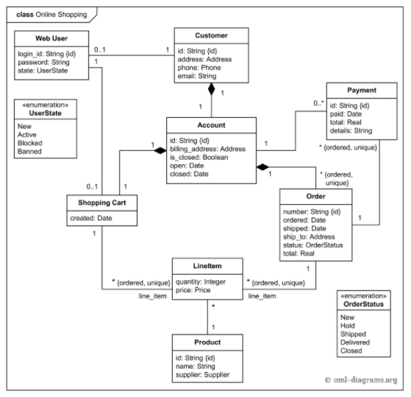
Class diagram for a E-Shop

Slide 31


Summary
What is a Class Diagram?
Why do we need class diagrams?
Class Representation in UML
Visibility of Class Members
Relationships
Exercises
  Class diagram for a banking system
  Class diagram for a E-Shop

